Slide 1
Executive functions and successful behavior
Thesis for doctoral degree (Ph.D)
2021
Torbjörn Vestberg
Illustration by Sofie Violett Pehrsson

Slide 2
Errata (Executive functions and successful behavior)
Important changes
Page 42, paragraph 5, line 7 - ηp2 (eta squared) is missing in front of 0.21.
Page 46, paragraph 1, line 5 – “Working group”, shall be removed.
Page 46, paragraph 6, line 4 – “Working group”, shall be removed.
Page 46, paragraph 7, line 4 – “Working group”, shall be removed.
Page 51, paragraph 3, line 6 – “(168-173) and other ball sports (174-182)”, shall be changed to “(173, 190) and other ball sports (174, 177, 182)”.
Page 57, paragraph 2, line 5 – “significantly” shall be changed to “in general”.
Page 57, paragraph 2, line 6 – “the results” shall be changed to “a significantly differences”
Page 59, Table 1 - Scharfen & Memmert 2021, Column/Correlation, the sign for significance is missing (*)
Page 60, Table 2 - Kruger et al 2019, Column/Main test, the sign for significance (*) shall be removed.
Page 60, Table 2 - Kruger et al 2019, Column/Level of play, the sign for significance (*) shall be removed.
Page 61, paragraph 5, line 8 – “coach assessment of Cognitive flexibility” shall be: ”coach assessment of game intelligence”.
Page 67, paragraph 5, line 2 – “function” shall be changed to “functional”.

Slide 3
Errata (Executive functions and successful behavior)
Other changes
Page 10, paragraph 3, line 4 – Change “Brain stem” to “Brainstem”
Page 23, paragraph 3, line 2 – r=0,32 shall be r=0.32 (period instead of comma)
Page 27, paragraph 5, line 1 – 30,4% shall be 30.4% (period instead of comma)
Page 27, paragraph 11. Line 9 – “The” shall be removed.
Page 35, paragraph 8, line 3 – 13,461 shall be 13.461(period instead of comma)
Page 35, paragraph 8, line 5 – “.10” shall be “0.10”
Page 50, paragraph 4, line 7 – “applicant” shall be changed to “student”.
Page 50, paragraph 5, line 1 – “Discuss and comment” shall be “discussed and commented”.
Page 57, paragraph 5, line 2 – “19,9 shall be “19.9” (period instead of comma)
Page 62, paragraph 3, line 13 - A comma shall be after thus”,”
Page 62, paragraph 4, line 6 - ”3)” shall be changed to ”4)”
Page 65, paragraph 3, line 6 – “stability” shall be removed.
Page 67, paragraph 2, line 5 and 7 – four comma signs shall be changed to period.
Page 75, paragraph 1, line 4 – “been” shall be removed.

Slide 4
Executive functions and successful behavior
Thesis for doctoral degree (Ph.D)
2021
Torbjörn Vestberg
Illustration by Sofie Violett Pehrsson

Slide 5
Executive functions and successful behavior
Survival of the fittest is the cornerstone of evolution.
The evolutionary pressure is about the ability to adapt.
Videos
In a quickly changing environment with a large degree of information processing, the ability to adapt is important for success.
The success factors for primates are flexibility and a creative flow.

Slide 8
Self-regulation - act to adapt!
The hunt was successful due to the chimpanzees' self-regulation.
The soccer players were successful due to their self-regulation.
Self-regulation helps primates accomplish different goals in a constantly changing environment.
The underlying functions of self-regulation - The executive functions.

Slide 9
Executive functions
Executive functions (EF) is an umbrella term for top-down cognitive processes that control thought and behavior, particularly in non-routine circumstances.
EF can be defined as the mechanism necessary to select goals and to create and maintain actions to reach these goals.
EF orchestrate the information processing and combine past experiences with the present situation.
EF optimize our behaviors.

Slide 10
Executive functions, CEF and HEF
EF may be separated in core executive functions (CEF) and higher order of executive functions (HEF)
CEF
Inhibition
Overcome distractions that may interfere with the goal.
Resisting temptation and not acting impulsively.
Working memory
Storing the information which no longer is present in the perception.
Manipulate the data by integrating past experience with the possible future.
Updating

Slide 11
Executive functions, CEF and HEF
CEF
Cognitive flexibility
The capacity to mentally alternate between rules and tasks.
Go back and forth between strategies, mental sets or actions.
Alter views or methods with the purpose to adjust and adapt to shifting difficulties.

Slide 12
Executive functions, CEF and HEF
HEF
The combination of different CEF used simultaneously in planning, reasoning and problem solving in order to achieve a goal.

Slide 13
Executive functions, CEF and HEF
HEF
Creativity and a creative flow
Constraints and frames are beneficial for creativity in order to promote the ability of adaptation.
Frank Gehry, one of the most acclaimed architects of the 20th century, particularly recognized for the spectacular Guggenheim Museum and Walt Disney Concert Hall, talks about how constraints and limitations are what really inspires his work.
Illustration by Sofie Violett Pehrsson

Slide 14
Earlier focus of EF
Deficits in EF capacity have been studied in relation to different disorders such as…
ADHD, autism, schizophrenia, bipolar disorder, depression, addiction, etc.
Is lower capacity of EF a consequence of a disorder or the cause?

Slide 15
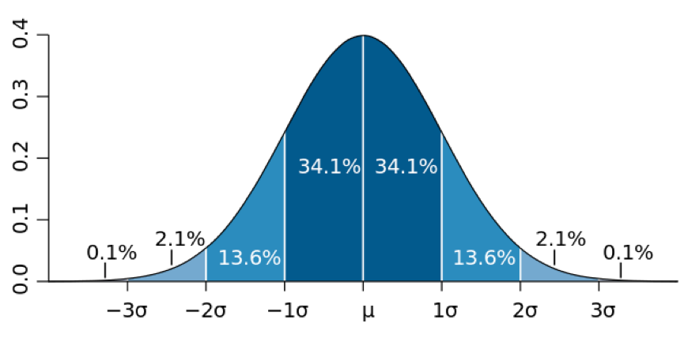
Earlier focus of EF
?

Slide 16
Aim
Based on the idea that self-regulation is essential for adaptation (survival of the fittest), the capacity of EF should play an important role both when it comes to preventing disorders but even more for successful behaviors.
Especially in a quickly changing environment with a large degree of information processing.
Investigate the relations between EF and successful behaviors with a focus on creative flow and cognitive flexibility.

Slide 17
Choice of research population
Soccer
study I, II, III
Special forces
study IV
Corporate world
study V

Slide 18
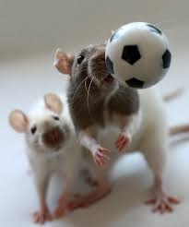
Soccer, study I, II, III
Semi-controlled environment.
Rules that constrains the actors (promote creativity)
Constantly new situations to solve in a quickly changing environment with a large degree of information processing (promote flexibility)
Constantly new demands of adaptation (promote flexibility)
Players act as free moving agents (make them compatible with each other. ”Who solved the mission in a best way”)
Clear measurement which defines success in soccer (easier to compare the EF result of the players with an objective measurement for success)

Slide 19
Special forces, study IV
Rules that constrains the actors (promoting creativity)
New situations to solve In a quickly changing environment with a large degree of information processing (promote flexibility)
Constant new demands of adaptation (promote flexibility)
More or less an agreement about what success is.
High emotional stress (The influence of the emotional regulation on EF)

Slide 20
The corporate world, study V
A large company on the national level,
Has sufficiently large selection of different working groups
Offers data of sick leave as a reversed index for health and a measurement for success through resilience against long-term sickness

Slide 21
Hypothesis
Soccer
Higher level of play demands higher EF capacity related to creative flow and flexibility
EF correlates with successful behaviors measured as scored goals and assists
Special forces
Top officers have higher EF capacity related to creative flow and flexibility
High capacity of EF indicates high resilience towards high levels of stress.
Corporate world
Creative flow and cognitive flexibility give resilience to long term sickness

Slide 22
Material and Methods
The Delis-Kaplan Executive Function System (D-KEFS)
Design fluency (DF) as the main test
It measures multi-processing in an ongoing situation with a focus on cognitive flexibility, creativity and flow
Three steps, Creative flow, Inhibition, Cognitive flexibility
Verbal fluency, study V
CWI and TMT were used as additional tests
Cogstate
Was used to measure and control other cognitive processes such as processing speed, attention, short-term memory and working memory

Slide 23
Design fluency
Primary measurement:
The amount of designs in
60 sec
Secondary measurement:
Accuracy
”Paper & pen”
tests

Slide 24
Design fluency and limitations
Involved different EF at the same time without differentiating among them
It reflects the reality of life better
Old norms (The Flynn effect)
The general level of the elite players from Study III showed no significant differences compared to study I (10 year between)
Re-test reliability is lower on DF3
DF shows in general a moderate to strong reliability but with a lower test-retest reliability in DF3 (r =0.32)
Re-test result is higher than baseline, suggesting a learning factor is involved rather than weakness in capture the capacity over time. The test has lost its novelty factor.

Slide 25
Results

Slide 26
STUDY I.
Part 1
57 players
29 elite, 28 semi-elite
31 males, 26 females
Selected by their coaches to be representative for their teams’ performances level
Part 2
25 male players
Played at least one game over the period of 2.5 years after testing.

Slide 27
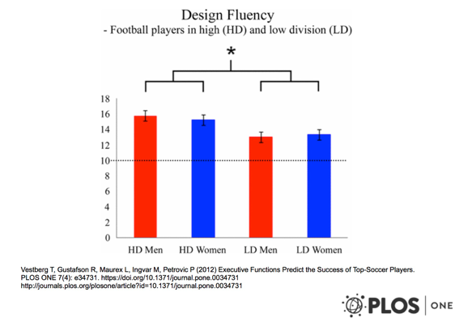
STUDY I.
Elite players significantly outperformed semi-elite in DF-total-correct (F(1, 53) = 13.86; p < 0.0005). There was no effect of sex.
The results remain after adjustment for education, age and position (F = 9.51; p = 0.004)
Similar results were shown in exploratory analyses.
The prospective part. DF-total-correct correlated significantly with numbers of goals and assists scored in two and half years. cf = 0.54; p = 0.006 (1-tailed) controlling for position, division level, and age.

Slide 28
STUDY II.
30 elite players were selected out of 49
Had scored at least once over a period of two years
Age range 12 to 19. Mean age 14.93

Slide 29
STUDY II. Average test-results of the group
Deficit
DF
National
team player 2018
”IQ”
DF
DF
Allsvenskan
2008
WorkMem

Slide 30
STUDY II.
dWM (working memory) from Cogstate correlated with scored goals made in two years (r = 0.437; p = 0.008 (one-tailed))
The results remain after controlling for age, height and IQ (r = 0.449; p = 0.009 (one-tailed))
DF-total-correct correlated with scored goals made in two years (r = 0.349; p = 0.029 (one tailed))
There was no correlation with IQ and scored goals (-0.01; p = 0.48).

Slide 31
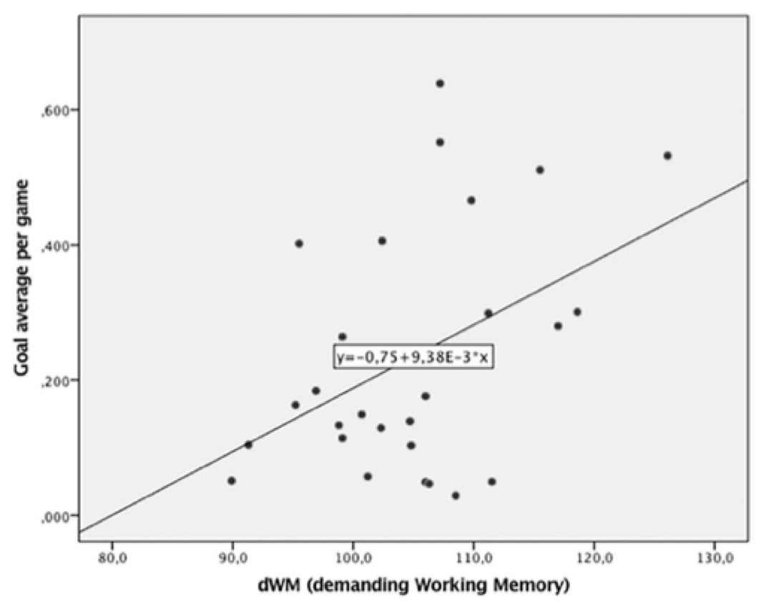
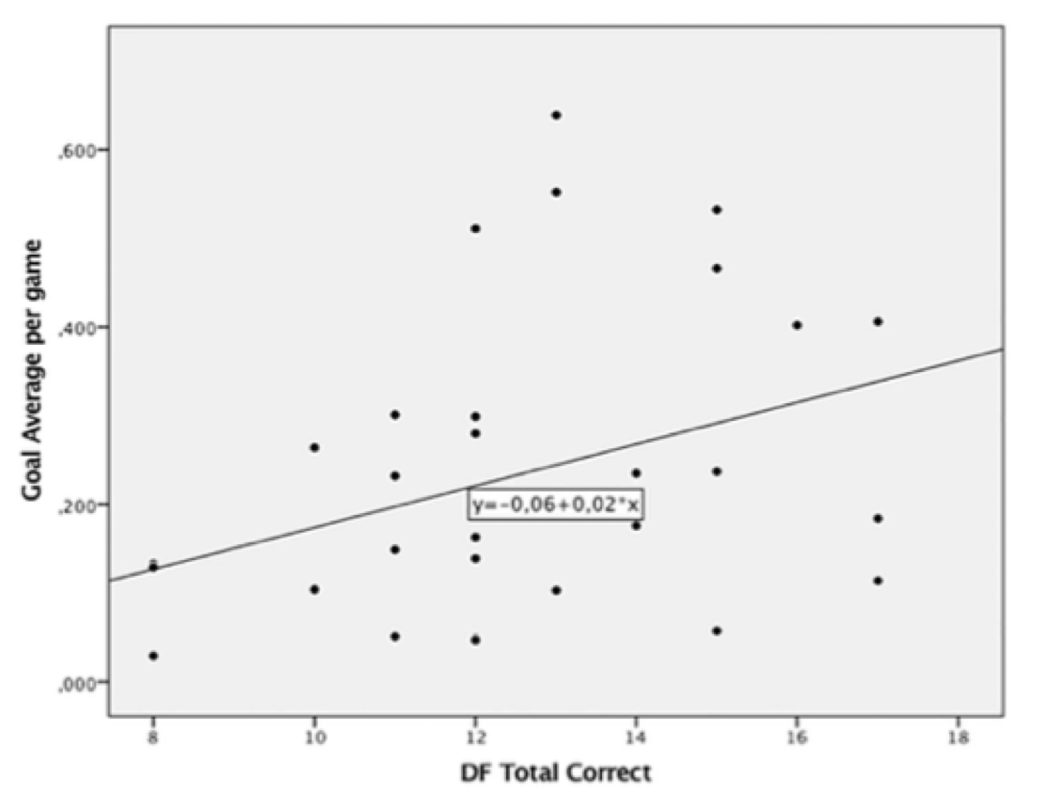
STUDY II. Correlation with scored goals
dWM
DF-total-correct

Slide 32
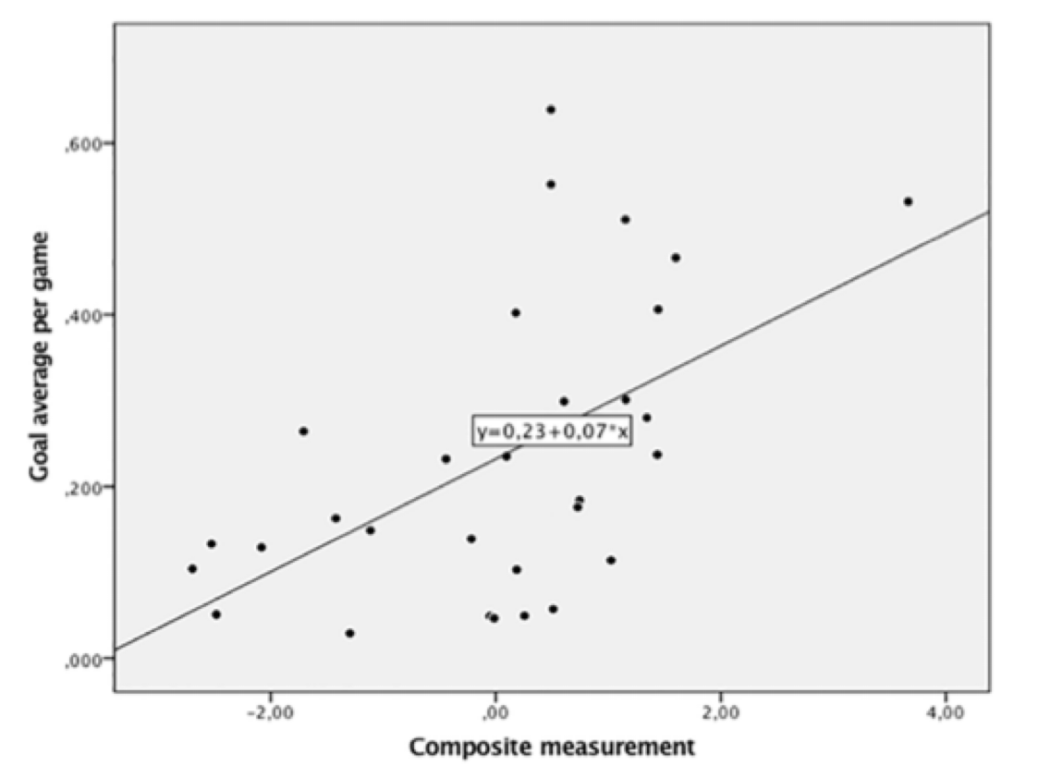
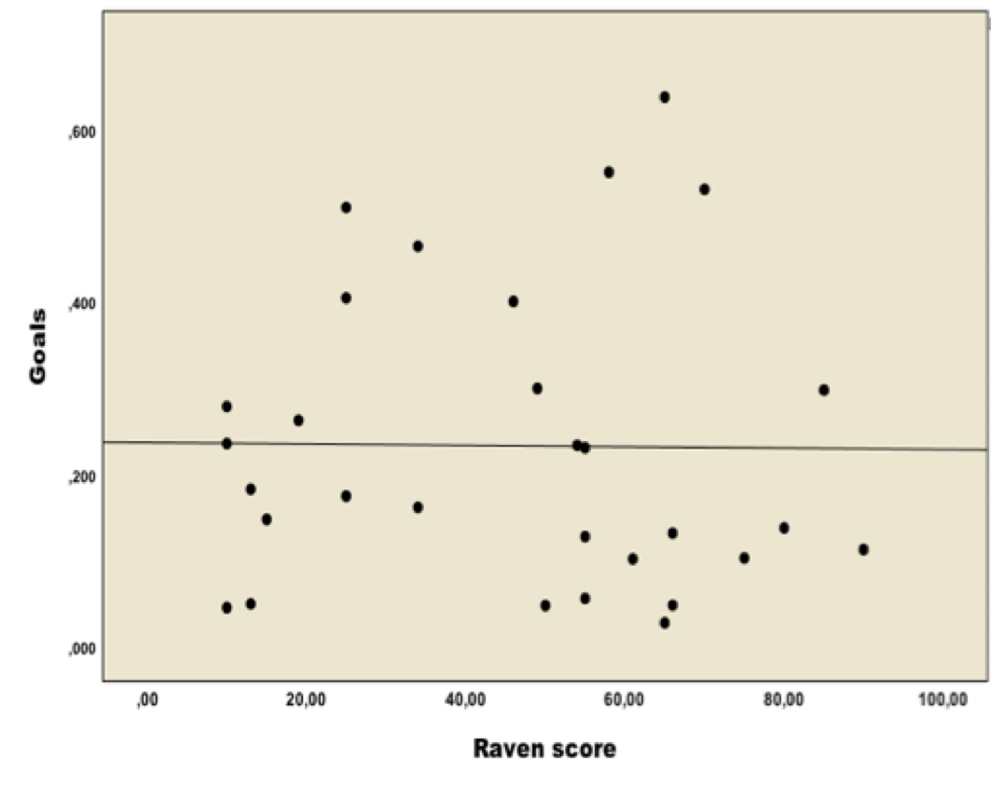
STUDY II. Correlation with scored goals
Composite
”IQ”

Slide 33
STUDY III.
51 players
28 national team players, 23 ”only” elite players (played in same teams)
19 males, 32 females (Some of which were considered to be the best in the world at the time)
Represented 14 nations

Slide 34
STUDY III.
National team players significantly outperformed elite players in DF-total-correct (t(42.67) = 2.48, p = 0.017, Cohen’s d = 0.71)
The results remained after adjustment for process-speed, short-term memory, sex, and age (F(1,45) = 5.96, p = 0.019, Cohen’s d=0.73)
Number of made assists, in one year, correlated significantly with the results of DF-total-correct (F(1,40) = 4.94, p = 0.032 Cohen’s d = 0.70), Adjustments were made for age, position, sex, and lower level of cognition.

Slide 35
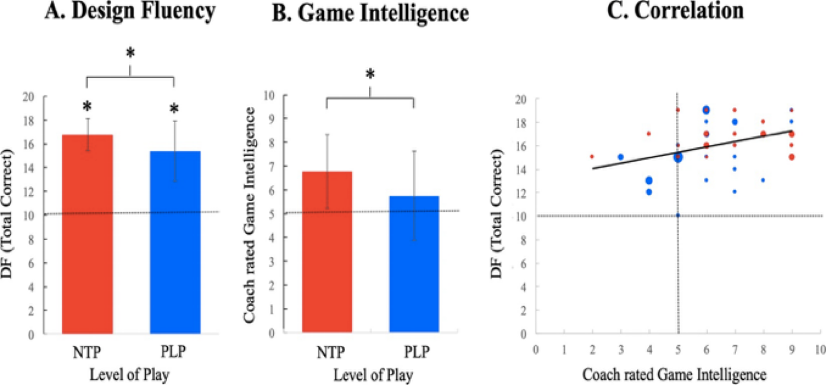
STUDY III. DF correlated significantly with game intelligence r =0.37, p = 0.008

Slide 36
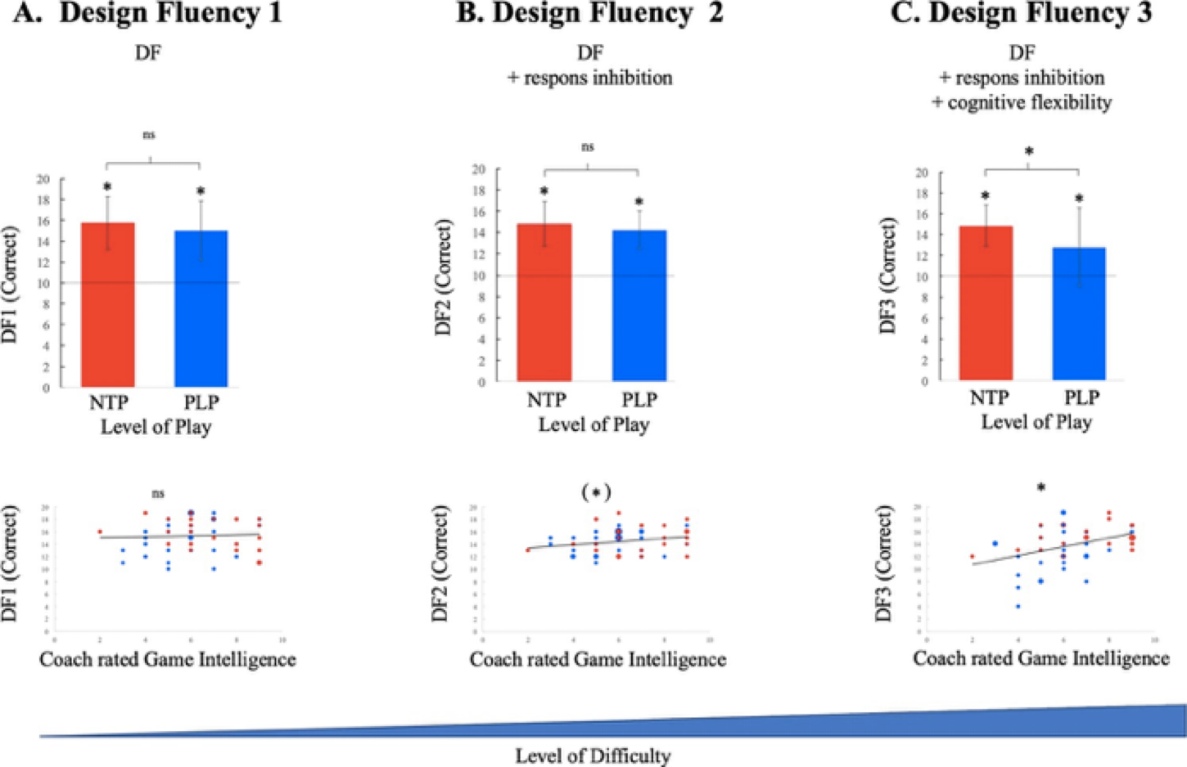
STUDY III. DF3 correlated significantly with game intelligence r = 0.37, p = 0.008

Slide 37
STUDY IV.
Part 1.
75 police officers
45 NI applicants
30 Police officer trainees
Part 2
Re-test of NI applicant under extreme field conditions

Slide 38
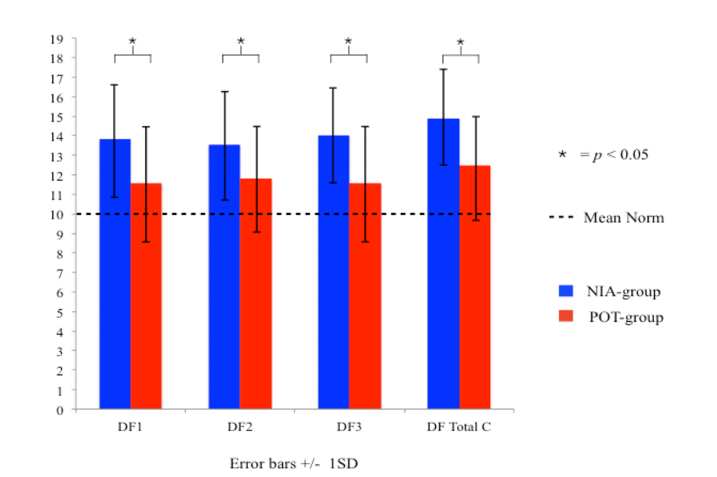
STUDY IV.
The NI applicants performed significantly better on DF-total-correct compared to the police trainee (t(42.67) = 2.48, p = 0.017, Cohen’s d = 0.71)
The results remain after adjustment for process-speed, short-term memory, sex, and age (F(1,45) = 5.96, p = 0.019, Cohen’s d=0.73)

Slide 39
STUDY IV. part 2 (High level of stress)
A paired sample-t-test with DF-total-correct showed no significant difference between the groups baseline results and the re-test results t(39) = -0.86, p = 0.39
There was a correlation between the individuals results of DF-total-correct tested in a relaxed environment (baseline) compared with the re-test made under physical and psychological stress in an extreme field condition r(40) = 0.49, p = 0.001

Slide 40
STUDY IV.
A paired sample t-test with DF3 (raised demand on the cognitive flexibility) showed a significant difference between baseline and re-test (t(39) = 3.79, p = 0.001). The group performed worse in the re-test.
There was a significant correlation between the individuals baseline results and the re-test result (r(40) = 0.49, p = 0.001).
The baseline results of DF3 compared with the re-test correlated negatively with the difference in results in percent r(40) = -0.46, p = 0.003.
Higher results in baseline gave higher drop in the re-test F(1, 35) = 9.16, p = 0.005, η_{p}2 = 0.21 (Cohan’s d = 1.03). Adjustment was made for processing speed, working memory, and resting heart rate.
However, in general, individuals with the highest baseline results still had the best scores in the re-test assessment.

Slide 41
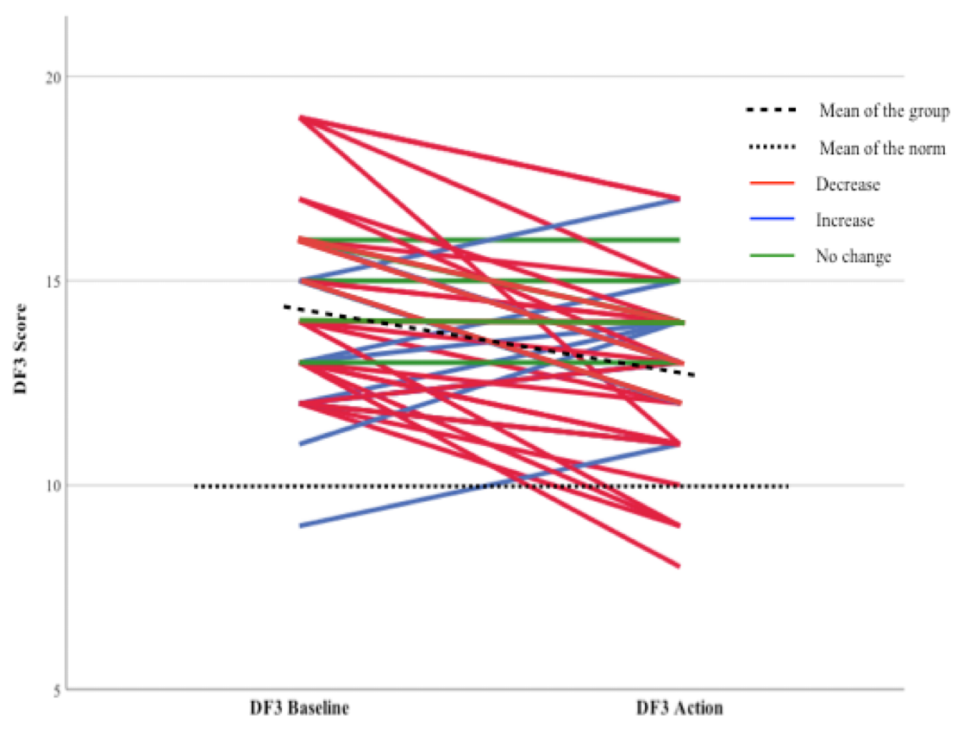
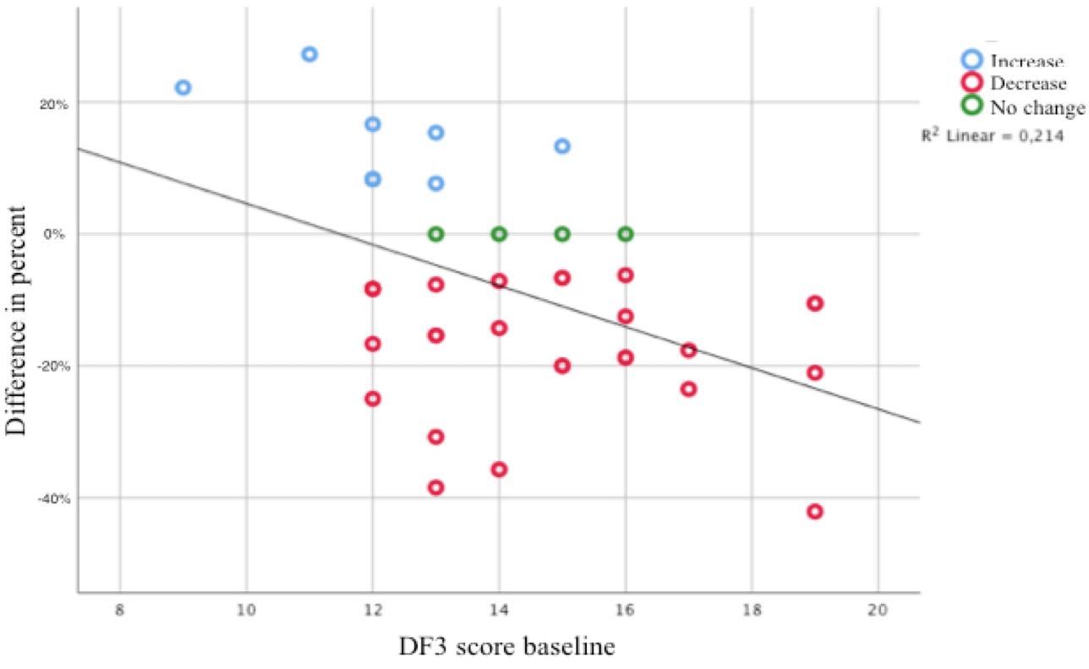
STUDY IV. (75 polices officers (45 NI, 30 Police trainee)

Slide 42
STUDY V.
111 co-worker
Forklift operators, sellers, operational managers, strategic managers
Derome, 2300 employees
HR department made the selection
The individuals should represent the company…
regarding geographic location,
age, and sex
Apart from the selection criteria above, the employees were chosen at random

Slide 43
STUDY V.
There was a significant negative correlation between the composite score of DF 1, 2, 3, VF1, 2, 3 (DFVF) and number of sick leave days the last five years (rs (111) = - 0.25, p = 0.007) non-parametric test.
Studying the individual that had at least hade one day of sick leave (74), using the log10 transformed data the results remain. It showed a significant negative correlation between sick leave and DFVF (Pearson’s r; r = -0.34, p = 0.003)

Slide 44
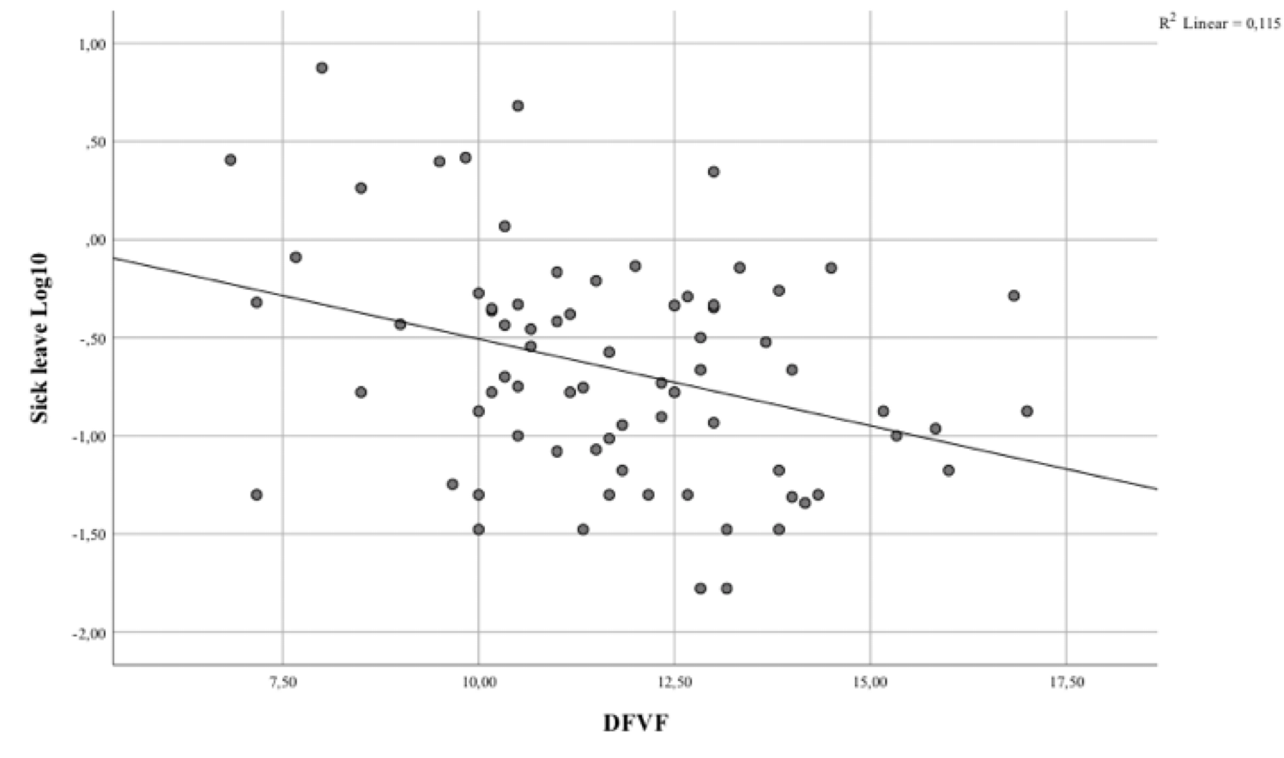
STUDY V.

Slide 45
STUDY V.
When adjustment was made for sex, age, work group, processing speed, attention, short-term memory, working memory and inhibition the main effect on DFVF remained (F(1, 62) = 10.84, p = 0.002, ηp² = 0.15, r = 0.39, d = 0.84).
There was also a significant effect of working group and inhibition. No other variables showed an effect on days of sick leave.

Slide 46
STUDY V.
There was a significant lower amount of sick leave among strategic and operational manager compared with folklift operators.
Strategic managers and operational managers had significantly higher results on DFVF.
However, the managers’ (working group) results did not influence the relations between DFVF and days of sick leave.
There was no differences in the results using DF or VF separately.

Slide 47
Conclusion
With a theoretical model built on evolution theory and the idea of the importance of successful adjustment through self-regulation to survive and thrive, each of the five studies have shown that EF are related to successful performance in contexts where there is a need to adjust behavior.
The interaction between working memory, inhibition and cognitive flexibility together with fluent creativity has shown to be important for successful behaviors in novel and quickly changing environments with a large degree of information processing.
The studies suggest that especially creativity in combination with cognitive flexibility contribute to successful behaviors.
However, the fourth study suggests that cognitive flexibility seems to be more vulnerable to stress than other EF components.
Although, cognitive flexibility and creative flow are of a special importance for adjustment in order to reach a goal, a range of EF-components are needed to complete the executive chain. However, it is likely that weaker capacity in one EF-component can be compensatory of another one.

Slide 48
Executive functions and successful behavior
Thesis for doctoral degree (Ph.D)
2021
Torbjörn Vestberg
Illustration by Sofie Violett Pehrsson

